Slide 1
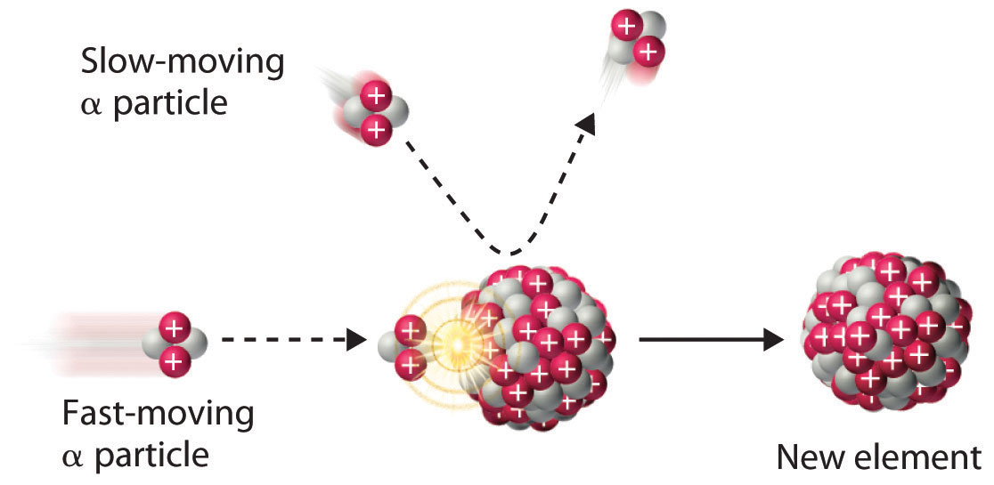
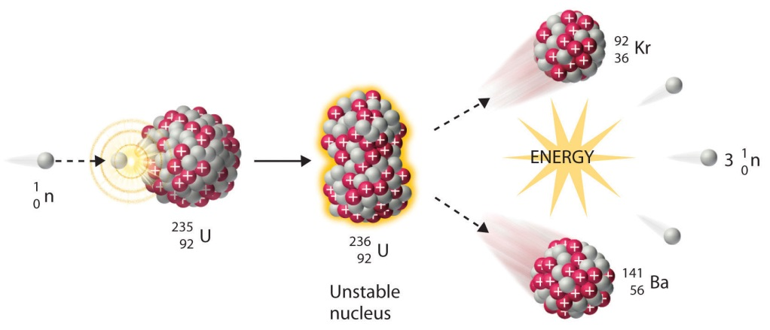
RDCH 702 Lecture 8: Accelerators and Isotope Production
Particle generation
Accelerator
Direct Voltage
Linear
Cyclotrons
Synchrotrons
Photons
XAFS
Photonuclear
Heavy Ions
Neutrons sources
Fission products and reactor
Spallation

Slide 2
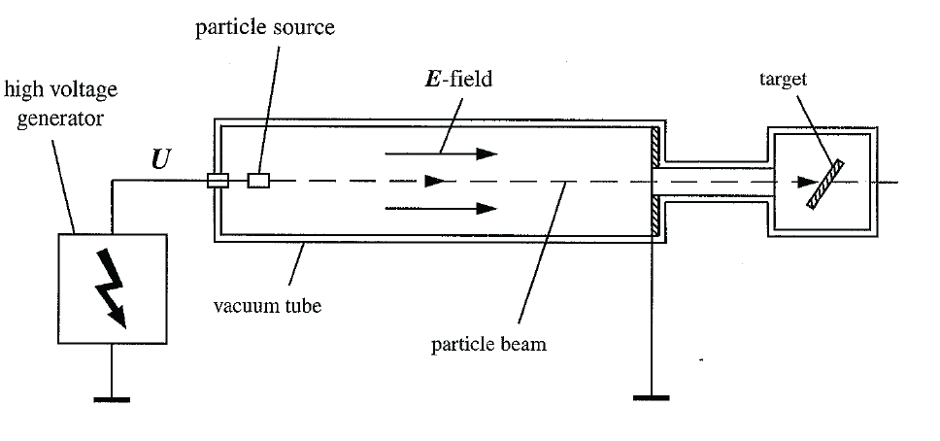
Charged Particle Accelerators: Direct Voltage
Use of electric fields to accelerate particles
First used in 1932 for protons
Cascade Rectifiers and Transformers
Direct application of voltage between terminals
Maximum voltage defined energy limit
Use multiple stages of voltage doubling circuits
Still used as injectors for high energy accelerator and neutron sources
Commercially produced

Slide 3
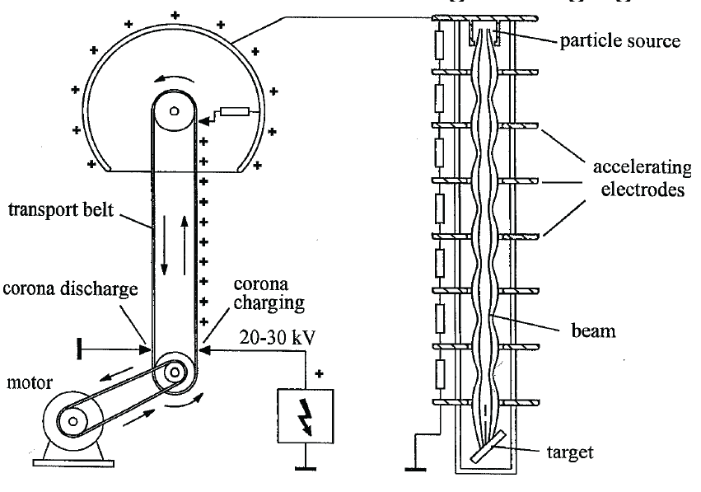
Van de Graaff Generator
Electrostatic Generator
All potential provide at one source
Higher potential than direct voltage
First built in 1929,
positive charges collected on a belt and used to charge a sphere
equilibrium between build up and loss dictates charge on sphere
Ion source or electron gun produces ions or electrons which are focused into accelerating tube
Accelerating tube
under vacuum
sections of metal define path
focused at ends of metal
Well focused beams can be produced
Magnetic analyzer may be needed to purify beam
H⁺, H₂⁺, H₃⁺ all accelerated

Slide 4
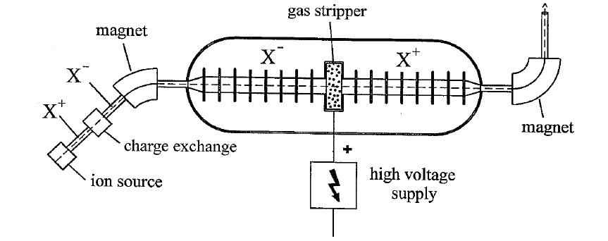
Tandem Van de Graaff Accelerator
Negative ions (H⁻) are accelerated towards positive terminal
Inside terminal ions are stripped of electrons
Positive ions further accelerated towards ground
Can couple more stages
Proton energies 25-45 MeV
Can also accelerate heavy ions

Slide 5
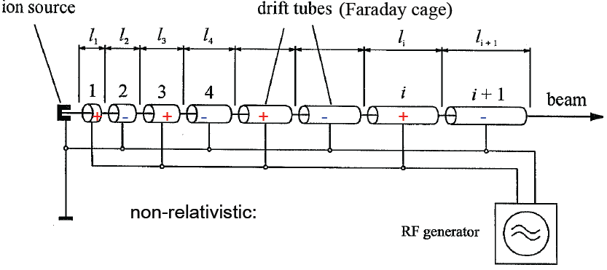
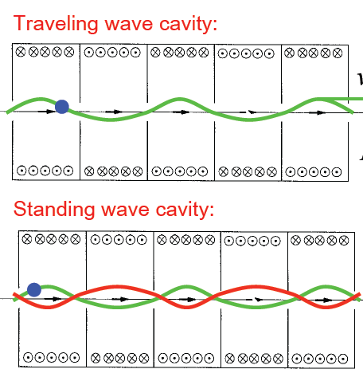
Linear Accelerator
Repeated accelerations through small potentials
Can use other accelerator output as source
Connection of coaxial sections
Alternating voltage
Ions accelerated at gap
First made in 1928
Range of cavities
Constant or varied in size
Traveling wave
Standing wave
Electron accelerators on similar principle
Pulsed machines
Up to ­ 20 GeV
Positron acceleration possible (at lower energies)
Used for electron scattering, photonuclear reactions, radiation therapy, industrial processing
SLAC around 2 miles

Slide 6
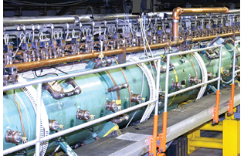
Proton Linacs
Protons and other positive ions have large velocity increase with energy
Standing wave acceleration
Drift tubes need to increase in length
Acceleration at gap between tubes
Large energies (up to 800 MeV at LANSCE)
Use protons as production tool
Mesons
Neutrons
Spallation products

Slide 7
HILACS
Heavy ion linear accelerator at LBL
Construction similar to tandem Van de Graaffs
Accelerate all types of heavy ions, up to U
Energies in range of 10 MeV/amu
Used in
relativistic experiments
nuclear structure
high energy nuclear collisions
injectors

Slide 8
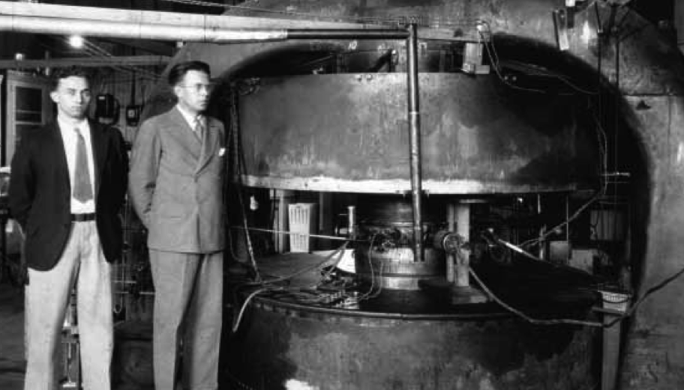
Cyclotrons
First built in 1930
Multiple acceleration by potential
Ions travel in spiral
Alternation of “dee” potential accelerates particles
Obeys equations of motion
mass m
charge q
velocity V
magnetic field B
radius R
angular velocity
Can control energy by varying terms
R often fixed, B can be varied

Slide 9
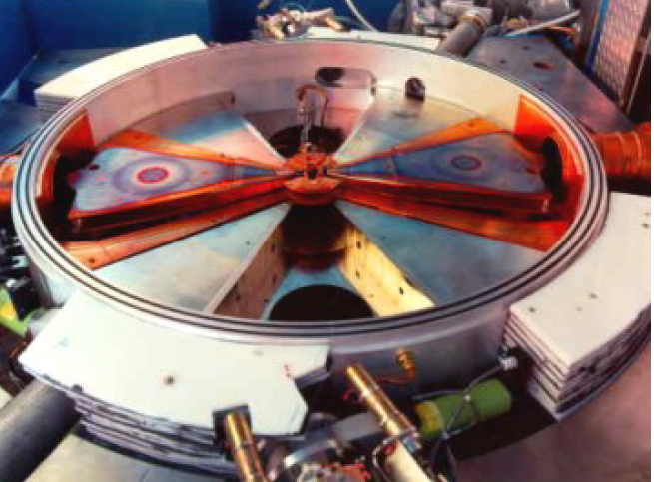
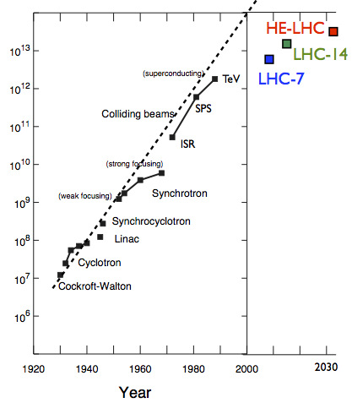
Cyclotrons
Fixed Frequency
accelerates chosen e/M ratio
different energies since M dependent
Sector focused
useful for heavier ions
creates hill and valley in regions
Cyclotrons can be combined with Linacs for high energy
eV

Slide 10
Photon Sources
Continuous spectra of EM radiation is emitted when relativistic electrons are in a curved path in a magnetic field
Relativistic velocity changes observed frequency due to Doppler effect
Lorentz factor (γ)
Time contraction also increase frequency by γ
Forward directed radiation
can choose wavelength of photons
useful for determining structure
IP, PES, EXAFS, XANES
Solid state physics
Reaction mechanisms
Perform many experiments simultaneously

Slide 11
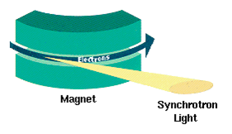
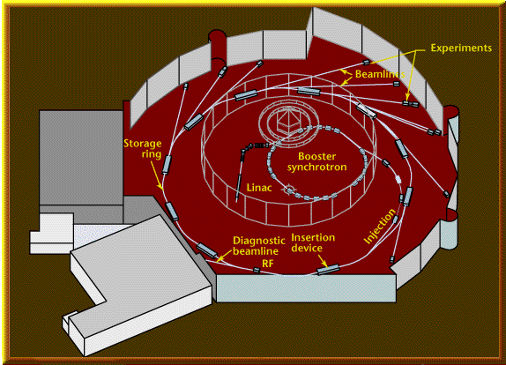
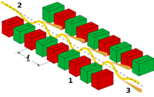
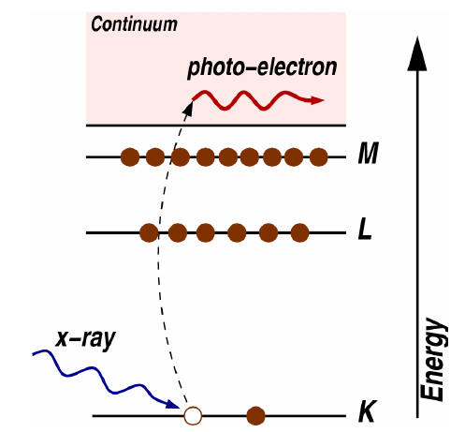
XAS Setup

Slide 12
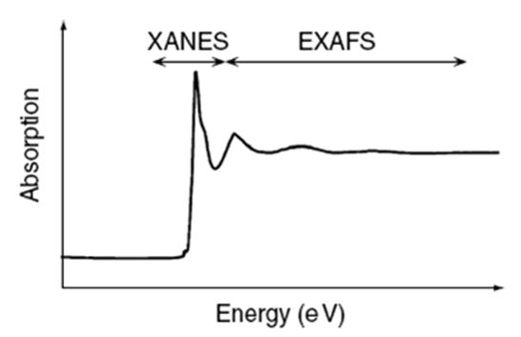
XANES and EXAFS
X-Ray Absorption Near Edge Spectroscopy (XANES)
Region between absorption edge and start of EXAFS oscillations, up to 40 eV above edge
Absolute position of edge contains information on oxidation state
Also contains information on vacant orbitals, electronic configuration, and site symmetry
Extended X-ray Absorption Fine Structure (EXAFS)
Above absorption edge, photoelectrons created by absorption of x-ray
Backscattering photoelectrons effect x-ray absorption
Oscillations in absorption above edge
Oscillations used to determine atomic number, distance, and coordination number of nearest neighbors

Slide 13
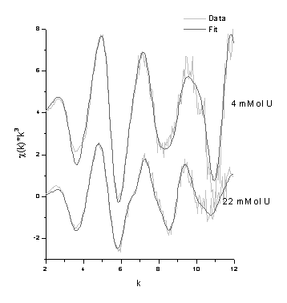
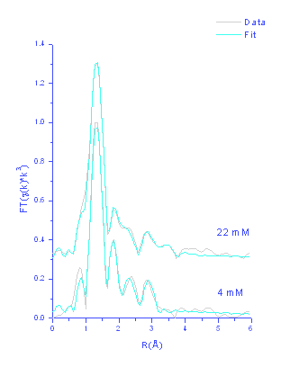
Bacteria EXAFS
EXAFS and Fourier transforms. Slight structural differences can be seen.

Slide 14
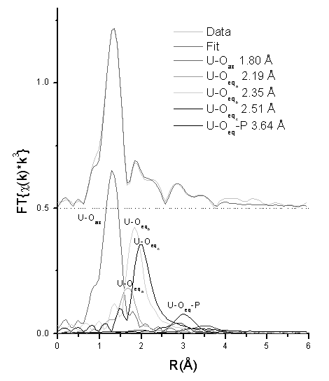
EXAFS Analysis
Structure is consistent with uranyl phosphate
Monodentate and bidentate P at 3.61 and 3.04 Å

Slide 15
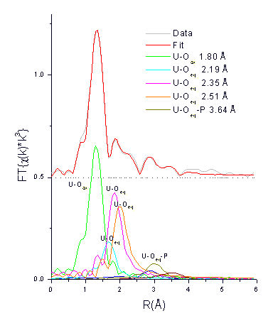
EXAFS Analysis
22 mM Sample
Mixture of phosphate and acetate structures
Due to high U concentration, phosphate possibly saturated

Slide 16
Neutron Sources
Radioactive sources (²⁵²Cf, reactions)
Accelerators
²H(d,n)³H
³H(d,n)⁴He
Neutron energy fast
also (γ,n) with ²H or ⁹Be
Alpha-neutron sources
Pu-Be sources
Reactors
specific design
high amount of ²³⁵U

Slide 17
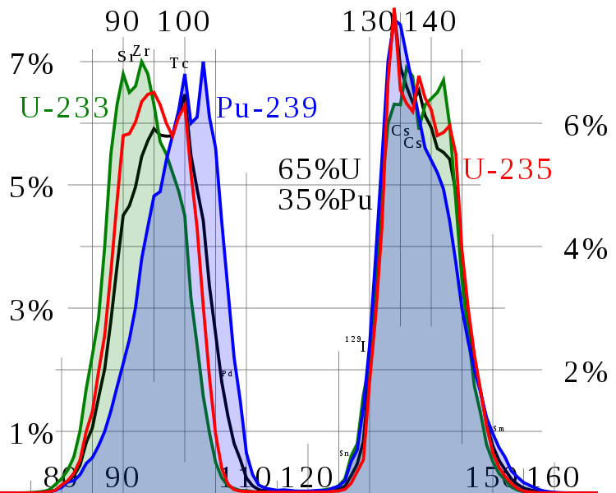
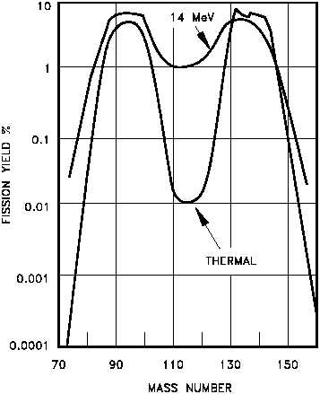
Fission Process
Usually asymmetric mass split
M_{H}/M_{L}≈1.4 for uranium and plutonium
due to shell effects, magic numbers
Heavy fragment peak near A=132, Z=50, N=82
Symmetric fission is suppressed by at least two orders of magnitude relative to asymmetric fission
Occurs in nuclear reactions
Competes with evaporation of nucleons in region of high atomic numbers
Location of heavy peak in fission remains constant for ^{233,235}U and ²³⁹Pu
position of light peak increases
2 peak areas for U and Pu thermal neutron induced fission
Influence of neutron energy observed
²³⁵U fission yield

Slide 18
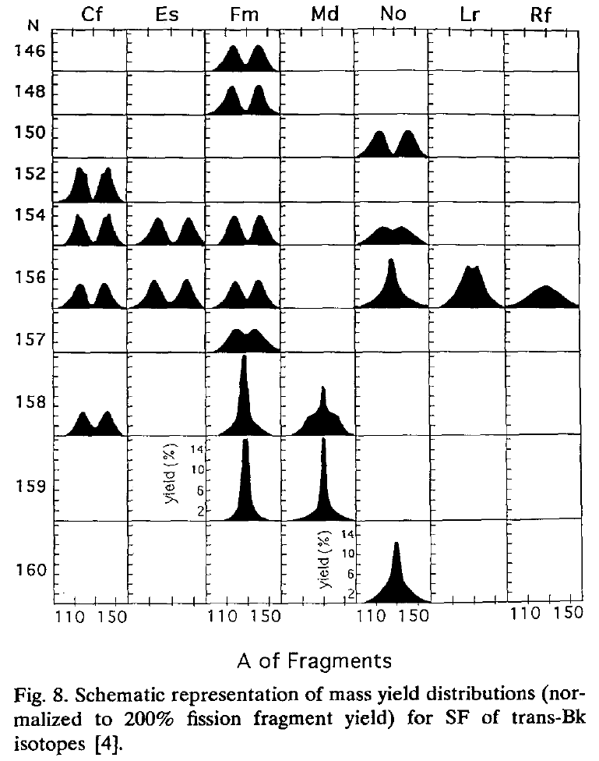
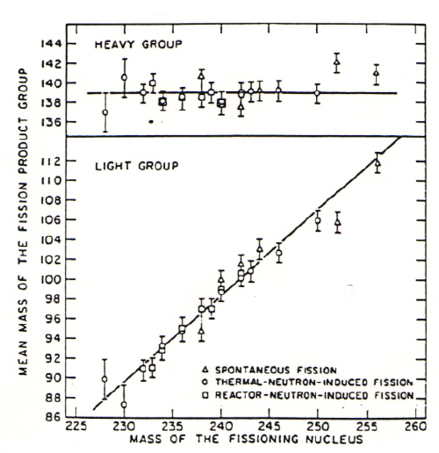
Fission Process
Fission yield distribution varies with fissile isotope
Heavier isotopes begin to demonstrate symmetric fission
Both fission products at Z=50 for Fm
As mass of fissioning system increases
Location of heavy peak in fission remains constant
position of light peak increases

Slide 19
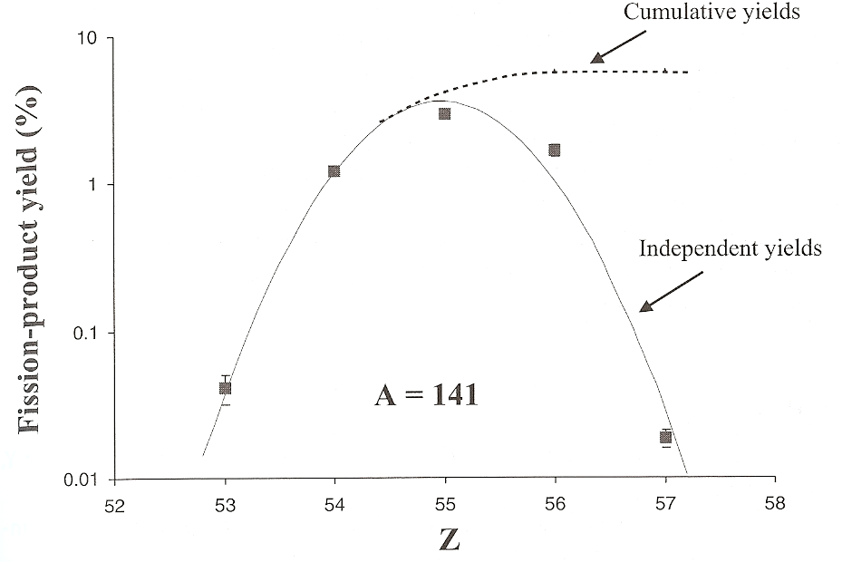
Fission products
Primary fission products always on neutron-excess side of β stability
high-Z elements that undergo fission have much larger neutron-proton ratios than stable nuclides in fission product region
primary product decays by series of successive β⁻ processes to its stable isobar
Yields can be determined
Independent yield: specific for a nuclide
Cumulative yield: yield of an isobar
Beta decay to valley of stability
Data for independent and cumulative yields can be found or calculated
Comparison of cumulative and independent yields for A=141
http://www-nds.iaea.org/sgnucdat/c2.htm

Slide 20
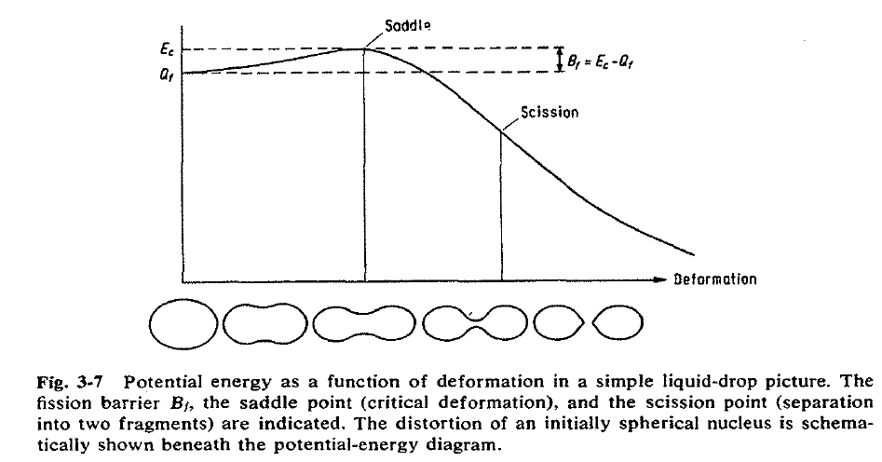
Fission Process
Nucleus absorbs energy
Excites and deforms
Configuration “transition state” or “saddle point”
Nuclear Coulomb energy decreases during deformation
Nuclear surface energy increases
Saddle point key condition
rate of change of Coulomb energy is equal to rate of change of nuclear surface energy
Induces instability that drives break up of nucleus
If nucleus deforms beyond this point it is committed to fission
Neck between fragments disappears
Nucleus divides into two fragments at “scission point.”
two highly charged, deformed fragments in contact
Large Coulomb repulsion accelerates fragments to 90% final kinetic energy within 10⁻²⁰ s

Slide 21
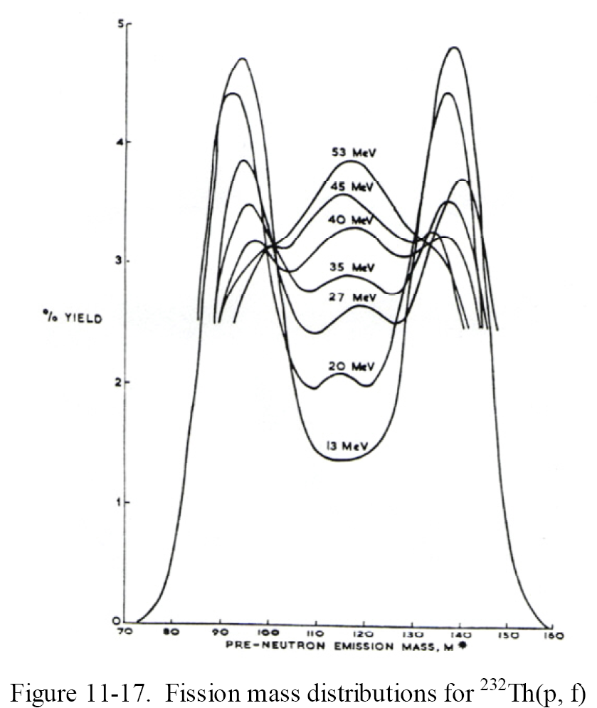
Proton induced fission
Energetics impact fragment distribution
excitation energy of fissioning system increases
Influence of ground state shell structure of fragments would decrease
Fission mass distributions shows increase in symmetric fission

Slide 22
Review Notes
Describe accelerators
Linear
Cyclotrons
Synchrotrons
XANES and EXAFS
Describe utilization of photons from synchrotrons
Provide example of neutron sources
Comment in blog
Respond to PDF quiz

